Slide 1

Google Play Store Data Analysis
SUBMITTED BY:
M. BALAJI

Slide 2
INTRODUCTION
Google Play Store is a digital distribution service operated & developed by Google.
Google Play also serves as a digital media store, offering music, books, movies, and television programs. Applications are available through Google Play either free of charge or at a cost. They can be downloaded directly on an Android device.
Google Play was launched on March 6, 2012, bringing together Android Market, and the Google under one brand, marking a shift in Google's digital distribution strategy.
In this study, analysis is mainly focused on different features of different apps in play store based on content rating, genres, categories, price etc….

Slide 3
OBJECTIVE
To analyze the different apps in google play store based on different features like category, genres, price, rating etc..
To find most popular apps based on highest installations.
To analyze popular categories and genres where more people are interested.
To find the various factors that will lead to detailed analysis of all apps in the play store.

Slide 4
DETAILS OF DATASET
File Name:
googleplaystore.csv
googleplaystore_user_reviews.csv
Length of Dataset – 10841 rows
Number of Columns - 13

Slide 5
DATA DESCRIPTION
Data Contains eleven columns namely,
App – Describes the name of the app.
Category – Describe category of the app which it belongs to.
Rating – Describes rating of the app out of 5.
Reviews– Describes the count of reviews for the app.
Installs – Describes the count of total installs of the app.
Content Rating – Describes the category of content of the app.

Slide 6
DATA DESCRIPTION
7. Genres– Describes the genre of the app.
8. Current Version – Describes current version of the app.
9. Android Version– Describes the android version of the app.
10. Price – Describes the Price of the app.
11. Type– Describes whether the app is Free or Paid.

Slide 7
DATATYPE OF COLUMNS
Data Contains eleven columns namely,
App– String (abc) Datatype
Category – String Datatype
Rating – Float Datatype
Reviews– Numeric Datatype
Installs – Numeric Datatype
Content Rating – String (abc) Datatype

Slide 8
DATATYPE OF COLUMNS
7. Genres– String (abc) Datatype.
8. Current Version – String (abc) Datatype.
9. Android Version– String (abc) Datatype.
10. Price – Float Datatype.
11. Type – String (abc) Datatype.

Slide 9

TOOLS USED
Tableau is a visual analytics platform transforming the way we use data to solve problems empowering people and organizations to make the most of their data. See How Tableau Works.

Slide 10
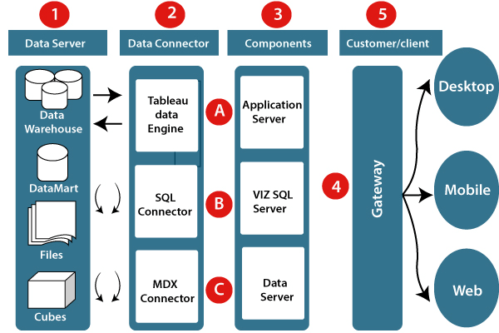
TABLEAU ARCHITECTURE

Slide 11
ETL OPERATIONS
Extract, Transform, Load operations include following:
Cleaning poorly formatted columns from the extracted raw data.
Skipping rows with Nan values.
Removing duplicated rows.
Changing the data types for necessary columns.

Slide 12
INSIGHTS

Slide 13
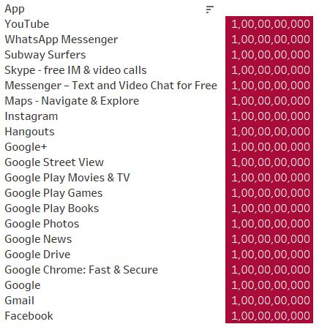
Top 10 Mostly Installed Apps

Slide 14
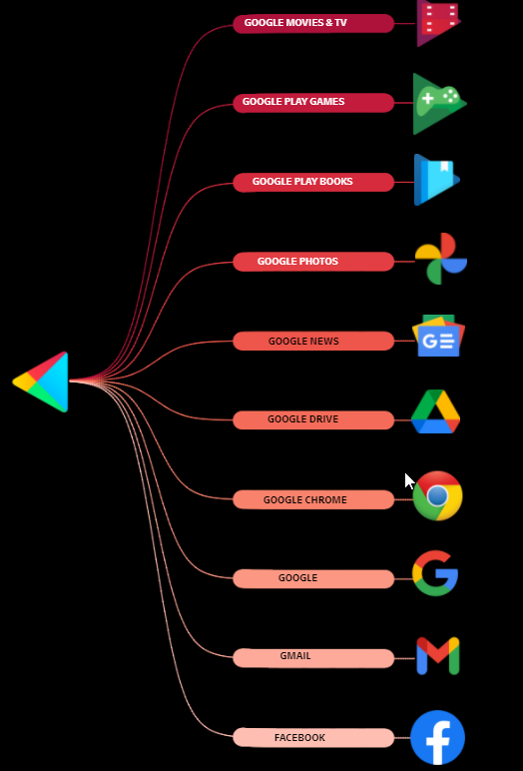
Top 10 Mostly Installed Apps
All the mentioned apps have more than 1 Billion Downloads.
In the top 10 mostly installed apps, 9 apps are belonged to Google.
The size of these apps are ranging in between 10 Mb to 100 Mb.
All the top 10 apps are free of cost and above 16+ can be able to use these apps.

Slide 15
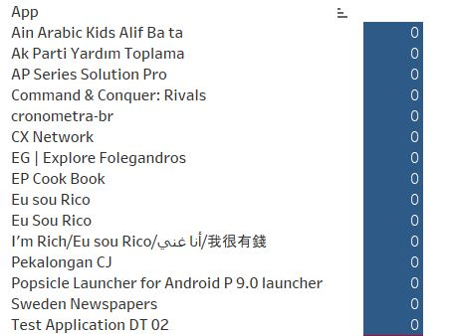
10 Apps with 0 Installs

Slide 16
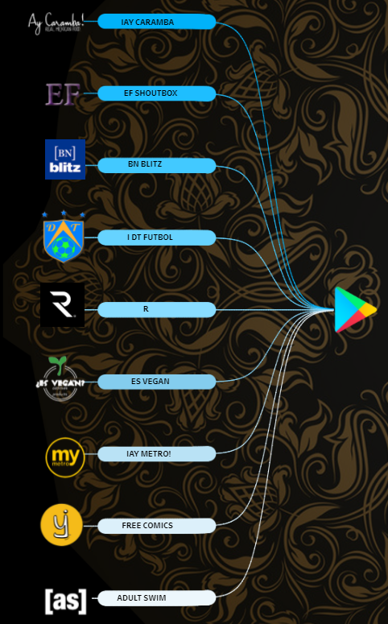
10 Apps with 0 Installs
All the mentioned apps have 0 installs
The size of these apps are ranging in between 10 Mb to 100 Mb.
Few apps can only be accessed by age above 18+

Slide 17
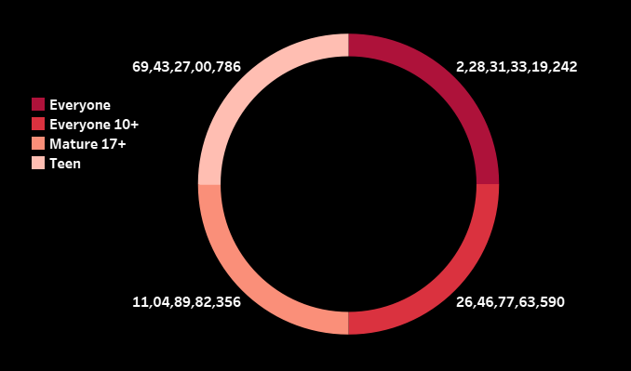
Total Apps based on Content Rating
Mainly there are 3 different contents. They are:
Everyone-The apps under this category can be accessed by everyone
10+ - The apps under this category can be accessed by the people’s age more than 10
Teen – The apps under this category can be only accessed by 18+

Slide 18
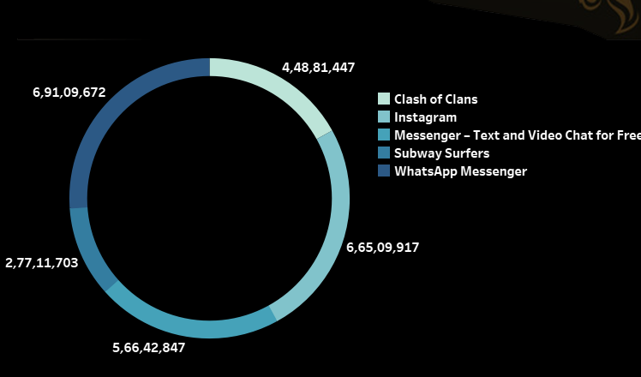
5 Mostly Reviewed Apps
WhatsApp Messenger is the mostly reviewed app with a count of approx. 7 Crore reviews.
Among 5 mostly reviewed app 3 apps i.e WhatsApp, Instagram, Messenger belongs to same company

Slide 19
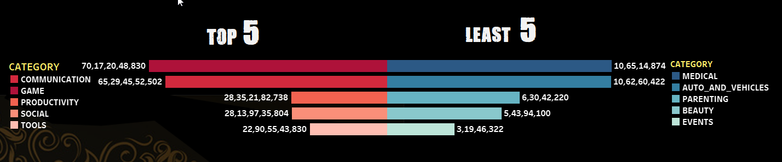
App Installs Based on Category
The apps under the category of Communication (e.g. Facebook, WhatsApp etc..)Are mostly downloaded with a count of 70 Billion+ downloads
The apps under the category of Events are less downloaded with a count of just 30 Million

Slide 20
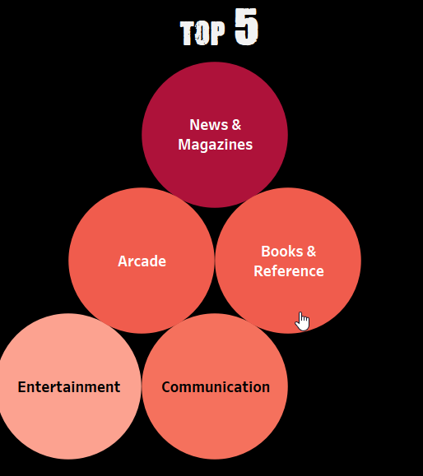
Top 5 Apps Based on Genres
The Genres related to News & Magazines are mostly downloaded with a count of more than 1 Billion.
Google News is one of the top app in News & Magazines genre.
WhatsApp is one of the top app in communication genre

Slide 21
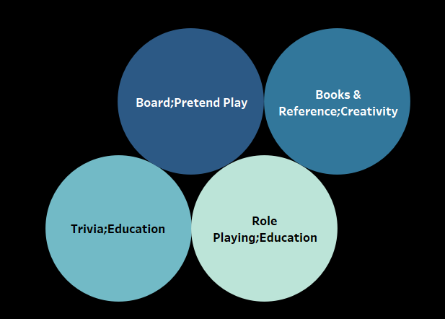
Least 5 Genres based on Installations
The mentioned 4 genres have least downloaded apps when compared to that of other genres

Slide 22
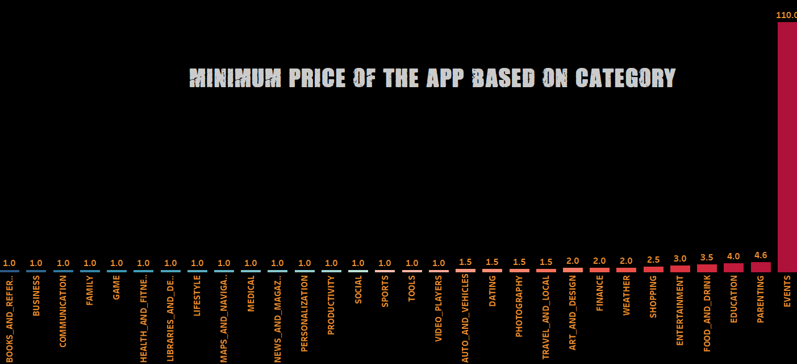
The minimum cost of apps in the category of Events starts from 110$ is the highest of all.
There are 17 categories in which the cost of paid apps starts from 1$
There are 9 categories in which the cost of paid is above 2$

Slide 23
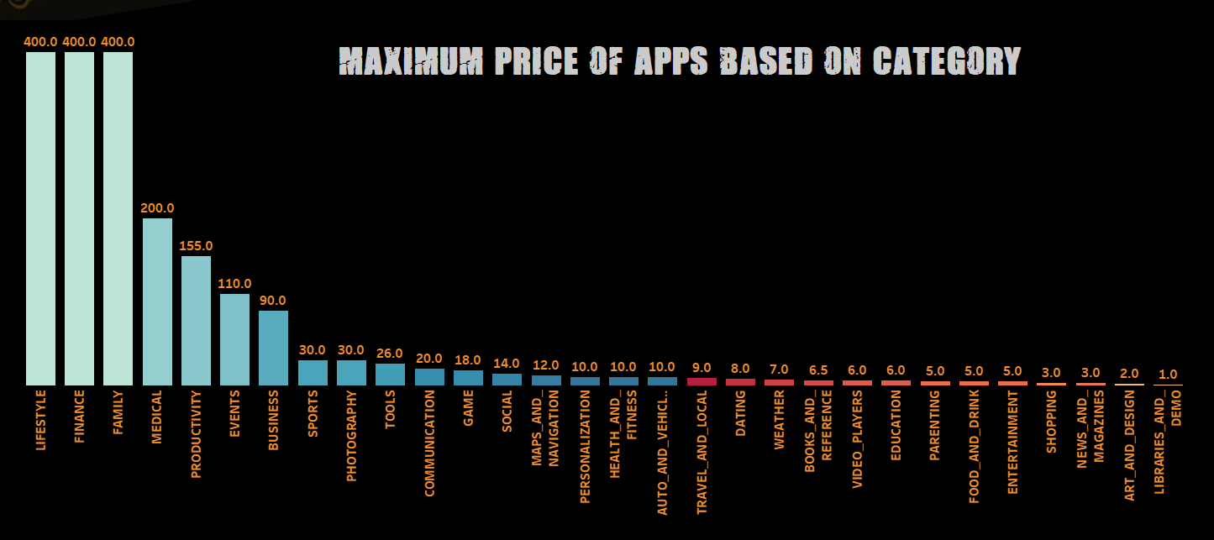
The maximum cost of apps in the category of Lifestyle, Finance, Family is 400$ is the highest of all.
There are 6 categories in which the cost of paid are above 100$
There are 16 categories in which the cost of paid is below 10$

Slide 24
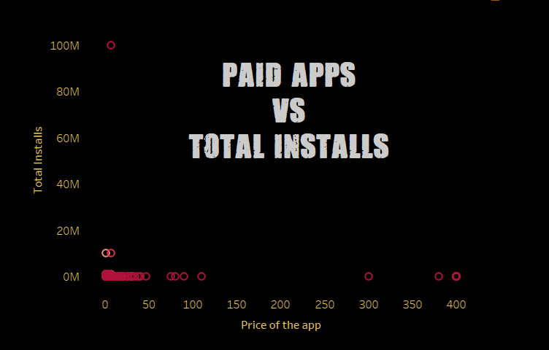
Calculator App is mostly downloaded paid app with a total installs of 100M with a revenue of 700M $
I Am Rich App is costliest app with a price of 400$ with a total installs of 100K with a revenue of 40M $

Slide 25
CONCLUSION
Top apps in Art & Design: Sketch – Draw & Paint, Textgram, Canva.
Top apps in Automobile: Android Auto, AutoScout24, Fines of State traffic Safety.
Top apps in Beauty: Beauty Camera – Selfie Camera, Best Hairstyle step by step.
Top apps in Books: Google Play Books, Amazon Kindle, Audiobooks by Audible, Bible.
Top apps in Business: Office Suite: Free office + PDF Editor, File Commander, Free office Suite.
Top apps in Comics: Line Webtoon – Free comics, Comics, Narrator’s voice.
Top apps in Communication: Hangouts, Gmail, Google Chrome, WhatsApp, Skype, Messenger.
Top apps in Education: Duolingo, Google Classroom, TED, Khan Academy.
Top apps in Entertainment: Google Play Games, Netflix, IMDB Movies , Hotstar, Amazon Prime.

Slide 26
Q & A
What's the Source of the Data - Collected from Given Data Set
Which tools you are used in this entire project – Tableau Public
How did you deploy the report - The report was deployed in my Tableau Public Server
What was the type of Data - Numerical and Categorical Values
What techniques are used for data pre-processing ?
Removing unwanted attributes.
Visualizing relation of independent variables with each other and with dependent variable.
Removing Outliers.
Cleaning data and imputing if null values are present.
Convert Categorical data to numerical data.

